Slide 1
Titanic
By R Praveenkumar

Slide 2
Objective
Analyze Titanic passenger data to understand survival patterns
Compare total passengers vs survivors
Study survival differences between males and females
Identify which class had the highest survival rate

Slide 3

How many passengers were on the Titanic, and how many of them survived?
There were 54 passengers on the Titanic in the dataset, and out of them, 24 passengers survived the disaster.

Slide 4


What is the total number of male and female passengers, and how many from each gender survived?
There were 26 male and 27 female passengers on the Titanic. Out of these, 4 males survived and 20 females survived.

Slide 5


What is the total number of passengers in each class (1st, 2nd, 3rd), and how many survived from each class?
1st Class: Total passengers = 11, Survived = 6 2nd Class: Total passengers = 9, Survived = 6 3rd Class: Total passengers = 33, Survived = 12

Slide 6
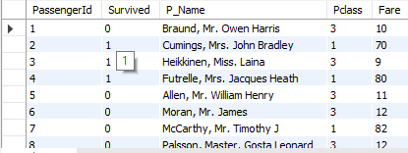
We have two tables, Passenger and PassengerFare. Use an INNER JOIN to combine these tables based on the common column PassengerId.

Slide 7


What is the average fare paid by passengers in each class (1st, 2nd, and 3rd)?
1st Class: Average fare = 78.00 2nd Class: Average fare = 26.22 3rd Class: Average fare = 12.42

Slide 8
Conclusion
A total of 54 passengers were analyzed
24 passengers survived, showing a survival rate of 44.4%
Females had a much higher survival rate than males
1st and 2nd class passengers had better survival chances than 3rd class
Travel class, fare, gender, and age played key roles in survival

Slide 9
Thank you

